Slide 1
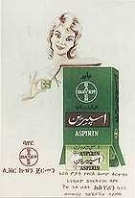
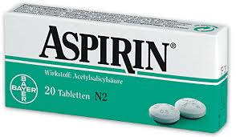
Synthese von Aspirin/ Umkristallisation
Notes:
• Wasserbäder aufheizen
• Nutschen zeigen

Slide 2
"Der gewöhnliche Mensch lebt heute sicherer als früher der Mächtigste. Was schert es ihn, wenn er nicht reicher ist als andere, wenn die Welt es ist und ihm Strassen, Eisenbahnen, Hotels, Telegraphen, Gesundheit und Aspirin zur Verfügung stellt."
Ortega y Gasset, 1883-1955, span. Philosoph

Slide 3
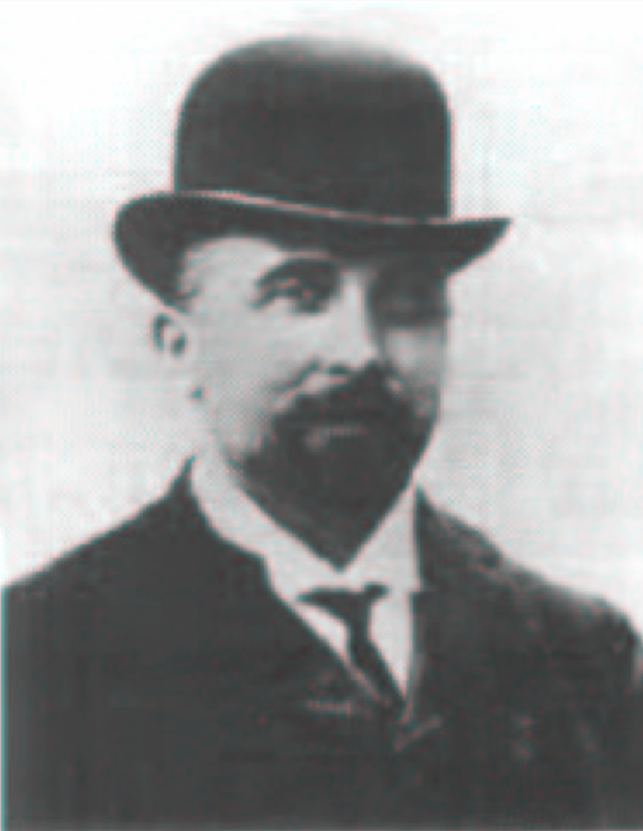
Erfinder von Aspirin: Felix Hoffmann?

Slide 4
Nein - Arthur Eichengrün

Slide 5
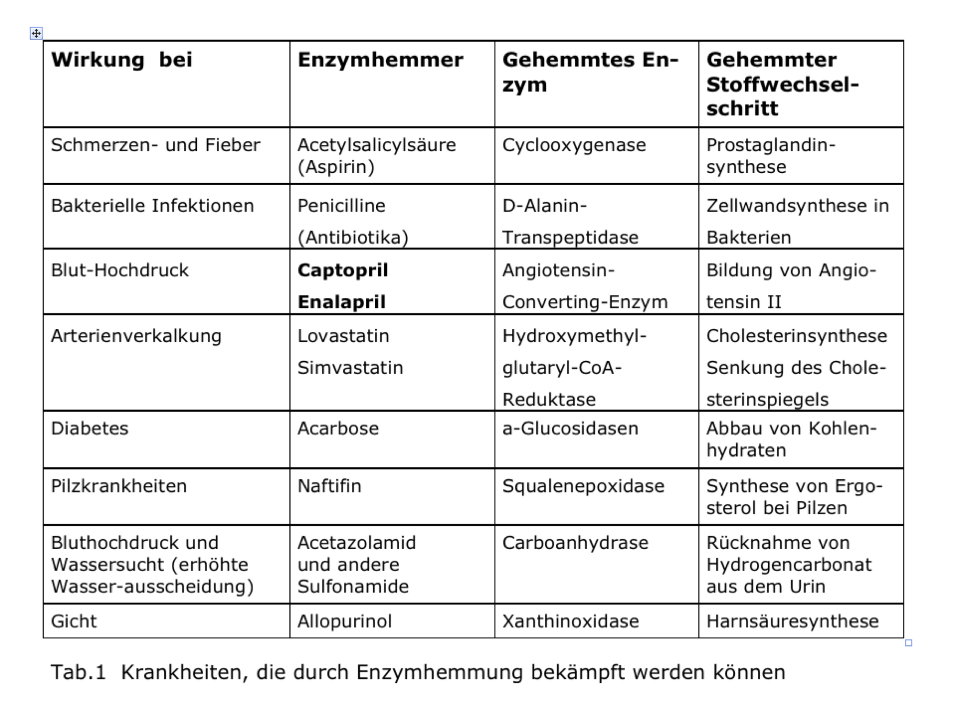
Wirkung von Aspirin

Slide 6
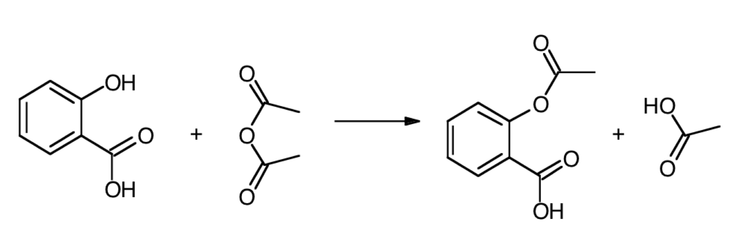
Synthese von Acetylsalicylsäure - Ausbeute
138.1 g/mol
180.2 g/mol
60.1 g/mol
102.1 g/mol

Slide 7
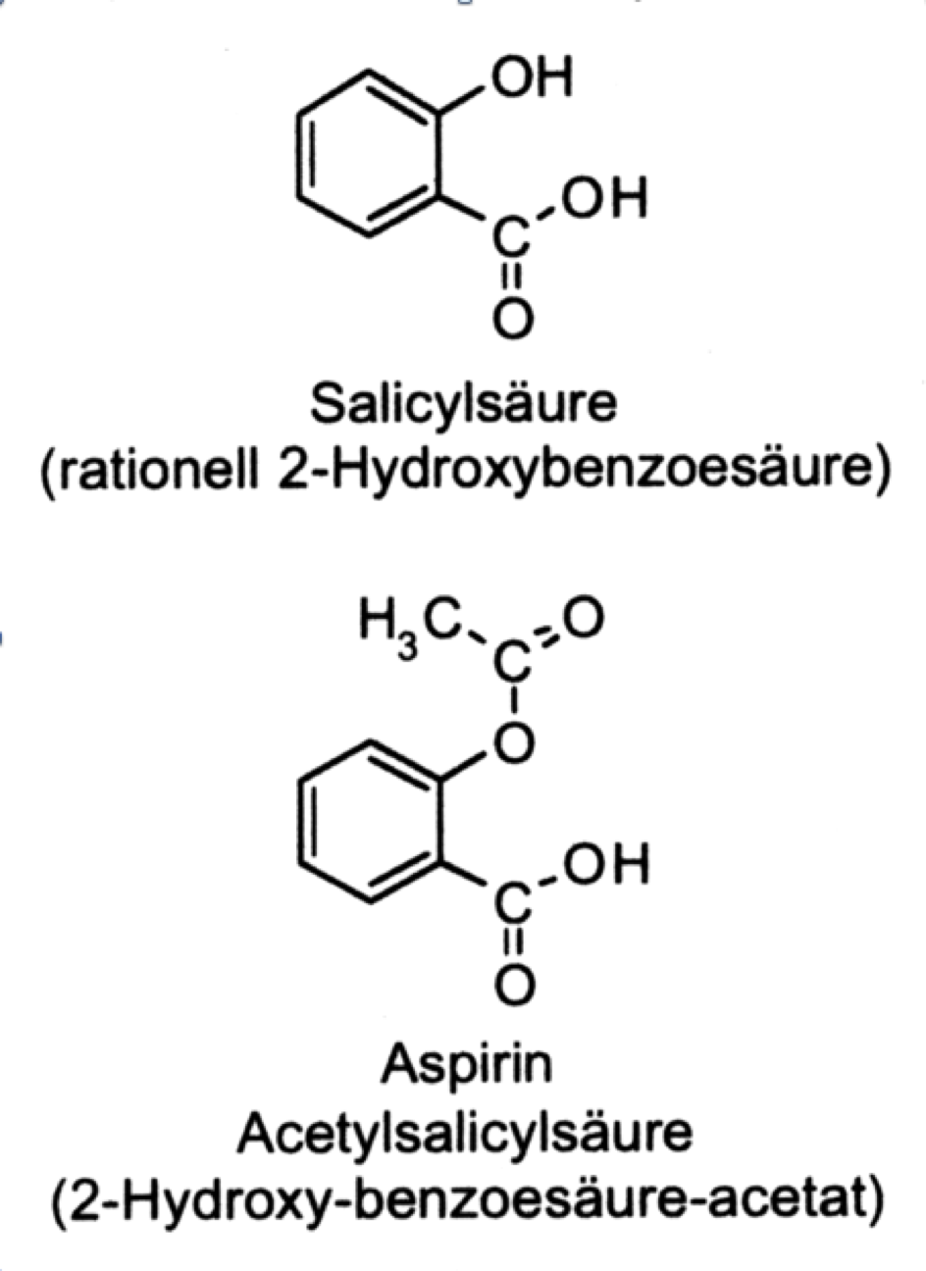
Synthese von Acetylsalicylsäure
Notes:
Robusta
As the name suggests the Robusta coffee plant is robust in every way. It is tougher, higher yielding and has double the caffeine content of the Arabica plant. It is tolerant to being grown right down to sea level. Robusta coffee is generally considered to be of inferior quality to the higher grown Arabica coffee plant and it sells for about half the price of the higher quality Arabica. Robsuta coffee is typically used to make instant coffees and is often used by large commercial coffee roasters to blend with Arabica to achieve a lower priced product aimed at the less discerning coffee market.
Arabica
Arabica coffee is known as high grown coffee. It is grown at elevations between 1,000-3,000m (3,300-10,000ft) above sea level. There are around 20 varieties of the Arabica plant all with different characteristics. Australian Arabica coffee ranks amongst the highest quality in the world, a status only enjoyed by 10% of the worlds coffee production.
Purely Blue coffee is an A-grade Arabica specialty coffee, picked between June and September each year when the coffee plant cherries have turned a beautiful rich red colour and are at their very best.

Slide 8
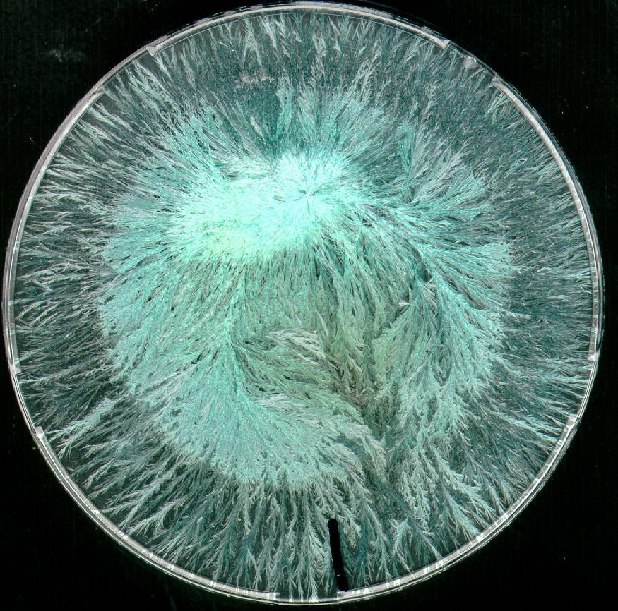
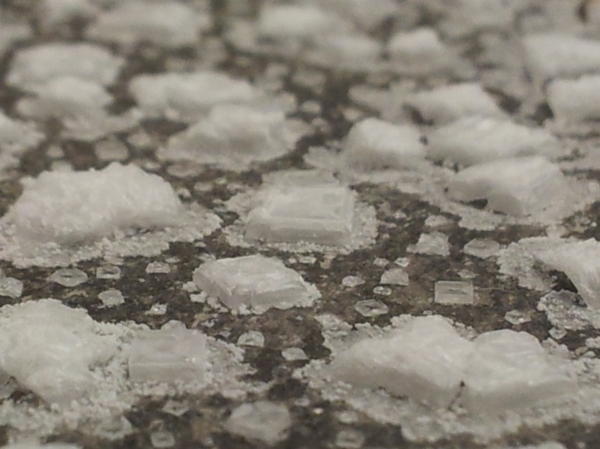
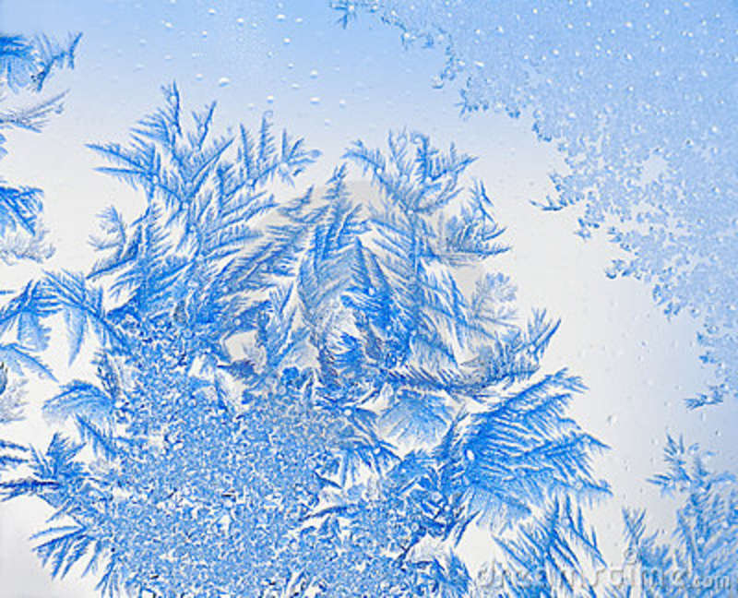
Reinigung durch Umkristallisation
Natriumchlorid
Kupferchlorid
Eiskristalle

Slide 9
Umkristallisation – Ablauf
I
IV
Produkt
Verunreinigung
Nur Produkt auflösen
III
II
Nur Produkt kristallisiert
Verunreinigung filtrieren

Slide 10
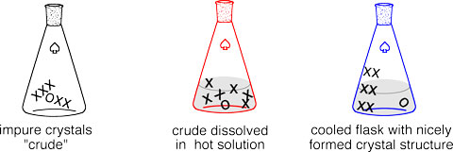
Umkristallisation - Ablauf
Erwärmung →Vollständiges Lösen des Gemischs in einem Lösungsmittel
Ev. Heissfiltration → Entfernen von schlecht löslichen Stoffen
Abkühlen → Entfernen von gut löslichen Stoffen
T↑
T↓

Slide 11
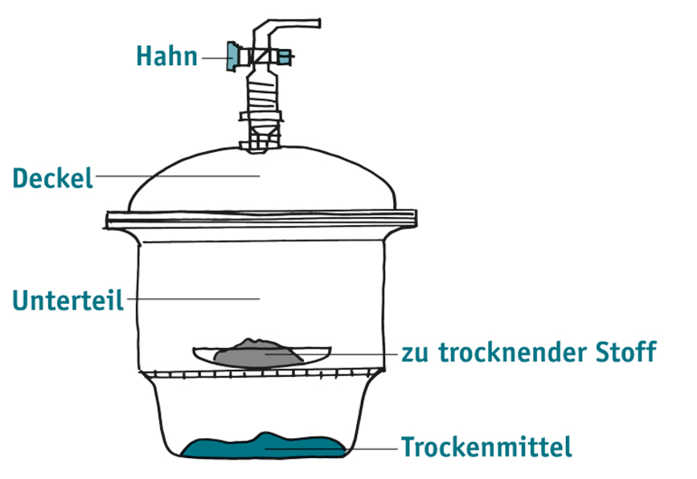
Ausbeute
Exsikkator:

Slide 12
Aufgaben

Slide 13
Aufgaben

Slide 14
Synthese von Acetylsalicylsäure - Ausbeute
138.1 g/mol
102.1 g/mol
180.2 g/mol
60.1 g/mol
Notes:
Robusta
As the name suggests the Robusta coffee plant is robust in every way. It is tougher, higher yielding and has double the caffeine content of the Arabica plant. It is tolerant to being grown right down to sea level. Robusta coffee is generally considered to be of inferior quality to the higher grown Arabica coffee plant and it sells for about half the price of the higher quality Arabica. Robsuta coffee is typically used to make instant coffees and is often used by large commercial coffee roasters to blend with Arabica to achieve a lower priced product aimed at the less discerning coffee market.
Arabica
Arabica coffee is known as high grown coffee. It is grown at elevations between 1,000-3,000m (3,300-10,000ft) above sea level. There are around 20 varieties of the Arabica plant all with different characteristics. Australian Arabica coffee ranks amongst the highest quality in the world, a status only enjoyed by 10% of the worlds coffee production.
Purely Blue coffee is an A-grade Arabica specialty coffee, picked between June and September each year when the coffee plant cherries have turned a beautiful rich red colour and are at their very best.

Slide 15
Lösungen

Slide 16
Lösungen

Slide 17
Umkristallisation – Weshalb?
• Eine der effektivsten Reinigungsmethoden für
verschiedenste Festkörper
• Kristalline Verbindungen sind leichter zu handhaben
• Stabiler als Lösungen oder Öle
• Leicht charakterisierbar

Slide 18
Umkristallisation – Weshalb?
• Eine der effektivsten Reinigungsmethoden für
verschiedenste Festkörper
• Kristalline Verbindungen sind leichter zu handhaben
• Stabiler als Lösungen oder Öle
• Leicht charakterisierbar

