Slide 1
The Remembrance Day Poppy

Slide 2
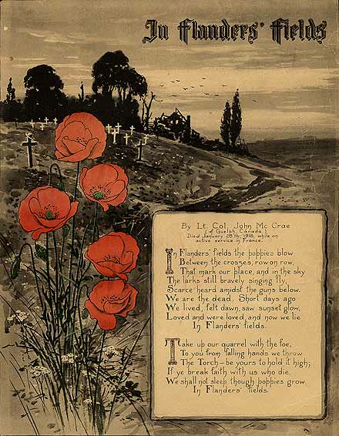
Notes:
The spring of 1915 was the first time that warm weather began to warm up the countryside after the cold winter at war in 1914-1915. In the region around Ypres in Belgian Flanders the months of April and May 1915 were unusually warm. Farmers were ploughing their fields close up to the front lines and new life was starting to grow. One of the plants that began to grow in clusters on and around the battle zones was the red field or corn poppy. It is often to be found in or on the edges of fields where grain is grown.
The field poppy is an annual plant which flowers each year between about May and August. It's seeds are disseminated on the wind and can lie dormant in the ground for a long time. If the ground is disturbed from the early spring the seeds will germinate and the poppy flowers will grow. This is what happened in parts of the front lines in Belgium and France. Once the ground was disturbed by the fighting, the poppy seeds lying in the ground began to germinate and grow during the warm weather in the spring and summer months of 1915, 1916, 1917 and 1918. The field poppy was also blooming in parts of the Turkish battlefields on the Gallipoli penninsular when the ANZAC and British Forces arrived at the start of the campaign in April 1915.
image: http://www.warmuseum.ca/cwm/exhibitions/remember/flandersfields_e.shtml
text: http://www.greatwar.co.uk/article/remembrance-poppy.htm
for an example of how the trenches would have looked like with poppies go to http://www.khakidevil.co.uk/Trench_Locations.html
(recreated trenches)

Slide 3
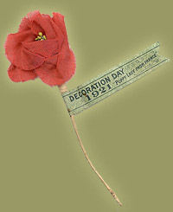
Notes:
The adoption of the poppy as a symbol of remembrance has international origins. The first person to use it this way was Moina Michael, a member of the staff of the American Overseas YMCA in the last year of the war. Michael read McCrae's poem and was so moved that she composed one of her own in response. She recalled later: "In a high moment of white resolve, I pledged to keep the faith and always to wear a red poppy of Flanders Fields as a sign of remembrance and the emblem of 'keeping the faith with all who died.'"
Consequently, she led a successful campaign to have the American Legion recognize the poppy as the official symbol of remembrance in April 1920. At the same time, Madame Anne Guerin, of France, inspired both by McCrae's poem and by Moina Michael's example, also became a vigorous advocate of the poppy as the symbol of remembrance for war dead. Her own organization, the American and French Children's League, sold cloth copies of the flower to help raise money to re-establish war-devastated areas in Europe.
In 1921, Guerin travelled to Britain and Canada on behalf of the poppy and convinced both the recently formed British Legion and the Canadian Great War Veterans Association (a predecessor of the Canadian Legion) to adopt the poppy as their symbol of remembrance as well. The first 'Poppy Day' in both countries occurred on 11 November 1921. The Returned Soldiers League in Australia adopted the poppy as its symbol of remembrance the same year.
For the first year, these artificial poppies were bought from Guerin's organization in France. By 1922, however, the various countries had started manufacturing them at home. In Canada, they were made by Vetcraft shops, run by the Department of Soldiers Civil Re-establishment and staffed by disabled soldiers. After its formation in 1925, the Canadian Legion (known as the Royal Canadian Legion since 1959) has run the poppy campaign in Canada.
An early edition of the Legion's magazine, The Legionary, explained the significance of buying poppies made by Vetcraft, as opposed to commercially available copies, as follows: "The disabled veterans in Vetcraft and Red Cross workshops are creating true memorials, while a poppy replica produced under ordinary commercial competitive conditions is nothing more nor less than an artificial flower."
The artificial poppy continues to flourish as the symbol of remembrance in the week leading up to the official commemorations on November 11. Today, millions of Canadians wear the bright red emblem to remember and honour the many thousands of their fellow Canadians who have died in war.
http://www.warmuseum.ca/cwm/exhibitions/remember/poppy_e.shtml

Slide 4
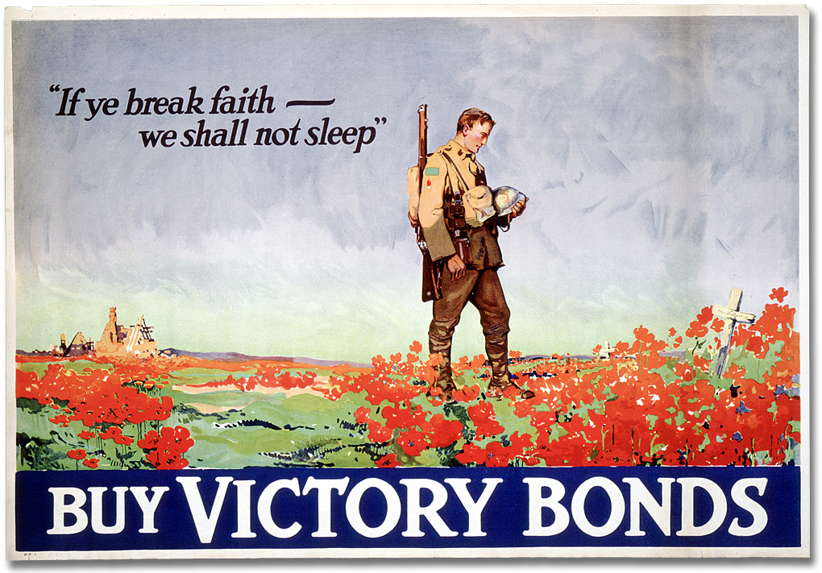
Notes:
First World War poster issued by the Canadian Government to sell Victory Bonds. Depicts a soldier standing in reflection at a grave site on a poppy strewn field in France. In the background to the left are some ruined farm buildings. The title runs across the bottom of the poster, and is printed in yellow ink. The quote "If ye break faith we shall not sleep" printed in dark blue in the top left corner of the poster is inspired by the poem 'In Flanders Fields', which was written by Canadian poet, physician and artist Lieutenant Colonel John Alexander McRae in May 1915 after his friend was killed during the battle for Ypres. The poem was first published anonymously in the 8 December 1915 edition of 'Punch Magazine'. The third verse was taken up and used as inspiration for the furthering of the war effort in several allied nations, especially in Canada and the United States.
image: http://www.archives.gov.on.ca/en/explore/online/posters/big/big_17e_war_poster.aspx
text: http://www.awm.gov.au/collection/ARTV00488/

Slide 5
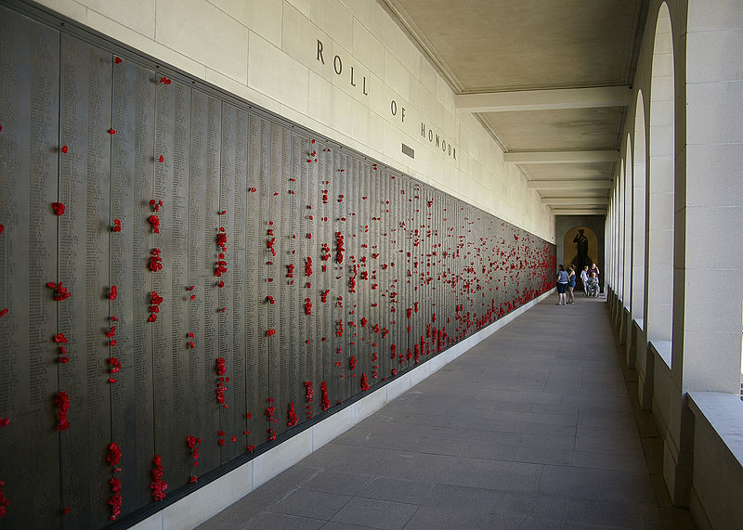
Notes:
The Roll of Honour records and commemorates members of the Australian armed forces who have died during or as a result of war service, or for Post-1945 conflicts, warlike service, non-warlike service and certain peacetime operations. It takes the form of bronze panels in the Memorial’s Commemorative Area and the Roll of Honour database, which is accessible via the Memorial’s website.
image: http://commons.wikimedia.org/wiki/File:Australian_War_Memorial_World_War_Two_Roll_of_Honor1.jpg
text: http://www.awm.gov.au/research/people/roll_of_honour/introduction/

Slide 6
Notes:
An image of wreaths of poppies at the Cenotaph in London after the Remembrance Sunday Service in Whitehall can be found at the following website: http://www.mirror.co.uk/news/uk-news/burning-poppies-is-moronic-but-what-happened-1432613

Slide 7
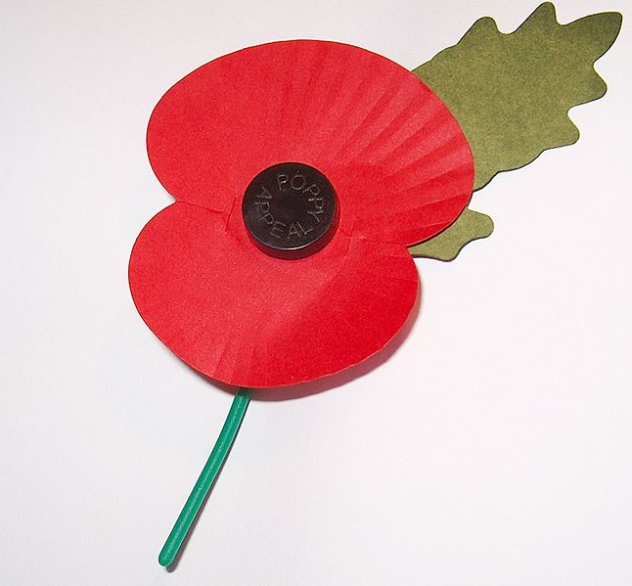
Notes:
http://en.wikipedia.org/wiki/File:Royal_British_Legion%27s_Paper_Poppy_-_white_background.jpg

Slide 8
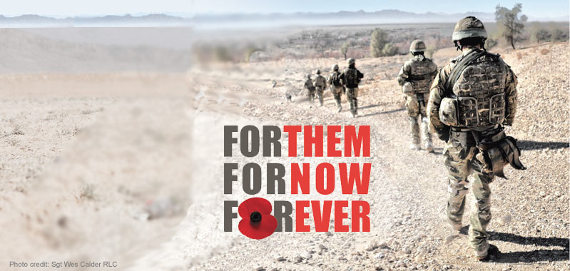
Notes:
Text next to the image (The Royal British Legion Website):
Remember all those who made the ultimate sacrifice.
At 11am on the 11th day of the 11th month, the nation will pause.
We will fall silent and take Two Minutes to reflect on the sacrifice of our brave Service men and women from conflicts past and present.
Join us to honour the fallen.
http://www.britishlegion.org.uk/remembrance/how-the-nation-remembers/plant-a-poppy

Slide 9
Notes:
images of Theo Walcott and David Beckham wearing poppies can be found at the following websites:
http://www.dailymail.co.uk/debate/article-2059653/FIFA-row-There-political-poppy-football-shirt.html
http://www.europeonline-magazine.eu/gedenken-mit-blutroten-blumen_304625.html
Fifa received much criticism for its decision to uphold a ban on the England and Wales football teams wearing poppies during matches.
Its rules disallow the wearing of political symbols, Fifa said, and "accepting such initiatives would open the door to similar initiatives from all over the world, jeopardising the neutrality of football".
For most in the UK that explanation didn't seem to be good enough. Neither were the other ways Fifa said it would allow the England team to pay tribute to servicemen and women including the laying of a wreath, holding a minute's silence, wearing black armbands and sporting embroidered poppies on their pre-match kit. […] As Tory MP Hugh Robertson wrote in a letter to Fifa: "The public feel very strongly about this issue, which is seen as an act of national remembrance to commemorate those who gave their lives in the service of their country.
"It is not religious or political in any way. Wearing a poppy is a display of national pride, just like wearing your country's football shirt."
But therein lies the rub.
For indeed some people argue even wearing a football shirt is a political issue – if not in England, then certainly in Palestine.
And perhaps these days virtually anything is political if you want it to be.
Or, sometimes, even if you don't.
http://www.huffingtonpost.co.uk/2011/11/09/poppy-politics-england-football_n_1083559.html

Slide 10
“There is a rather unpleasant breed of poppy fascism out there - 'He damned well must wear a poppy!’”
(John Snow, 2010)
Notes:
[John Snow is a famous and renowned journalist and news presenter on Channel 4 (winning the prestigious “presenter of the year award” from the Royal Television Society in 2013). Channel 4 is regarded as one of the best news programmes in the UK. He was involved in a “poppy scandal” in 2010 when he refused to wear a poppy as a news anchor.]
Writing on a Channel 4 blog, Mr Snow admitted the absence of a poppy on his lapel had prompted viewer complaints. He said he respected the armed forces and wore a poppy off-air but did not believe in wearing symbols on air. Veteran broadcaster John Humphrys said the poppy was a sign of respect and Mr Snow had "missed the point, entirely". […] The newsreader [Snow] said he did not believe in wearing anything on air which represented any kind of statement.
He said: "I am begged to wear an Aids ribbon, a breast cancer ribbon, a Marie Curie flower... You name it, from the Red Cross to the RNIB, they send me stuff to wear to raise awareness, and I don't.
"And in those terms, and those terms alone, I do not and will not wear a poppy. Additionally there is a rather unpleasant breed of poppy fascism out there - 'He damned well must wear a poppy!'. Well I do, in my private life, but I am not going to wear it or any other symbol on air.”
http://news.bbc.co.uk/2/hi/uk/6134906.stm
[more background is provided in the following excerpt from a Daily Mail article]
A viewer, writing under the name Stan, posted a comment on Mr Snow’s blog telling the presenter he was ‘dishonouring’ the war dead because he had refused to wear a poppy during broadcasts.
The remark provoked an angry response from Mr Snow, who said soldiers had died so that people had the freedom to choose when and where not to wear the symbol.
He cited a wave of ‘poppy fascism’, in which public figures are criticised for not wearing the poppy when appearing on television.
On the Snowblog site, Stan said of Mr Snow: ‘Jon, when you ride your bike, do you ever think of the hundreds of thousands of British troops who gave their lives in World War II to keep our great country free.
‘You alone dishonour them by not wearing a poppy. You look what you are on your bike.’ But Mr Snow replied: ‘Stan, they died that we might be free to wear a poppy whenever we wish. I wish to wear mine on Remembrance Sunday. When you wish to wear yours is your business. Compelling people to wear poppies because YOU think they OUGHT to is precisely the poppy fascism, or intolerance, that I have complained of in the past. On yer bike Stan, with or without a poppy, it is all your own free choice. Hitler lost the war!’
Mr Snow received some support, however. One blogger wrote: ‘Stan, I like to have a go at Jon for his political bias, but you are out of order for criticising anyone for not wearing a poppy. That is a choice in this country we are allowed to make.’
Others also said that the fact that all of the BBC’s presenters were apparently being told to wear them was simply a ‘cosmetic show’. Mr Snow drew attention to the row on Twitter, later adding: ‘They died that we might choose... I shall choose to on Remembrance Sunday in concert with others, in church, not on telly.’ He added that he had already bought his poppy in case none was left when he returns from covering the U.S. mid-term elections
Read more: http://www.dailymail.co.uk/news/article-1326063/Jon-Snow-poppy-fascism-row-C4-News-host-refuses-surrender.html#ixzz33NWeZk22
image of John Snow: http://maciverblog.co.uk/wp-content/uploads/2014/04/Jon-Snow-006.jpg

Slide 11
Notes:
Has WW1 merchandising gone too far?
A photograph of all kinds of poppy souvenirs sold in Flanders can be found at the following website:
image: http://www.bbc.com/news/world-europe-24842067

