Slide 1
Anti-Japanese Propaganda Posters in the USA

Slide 2
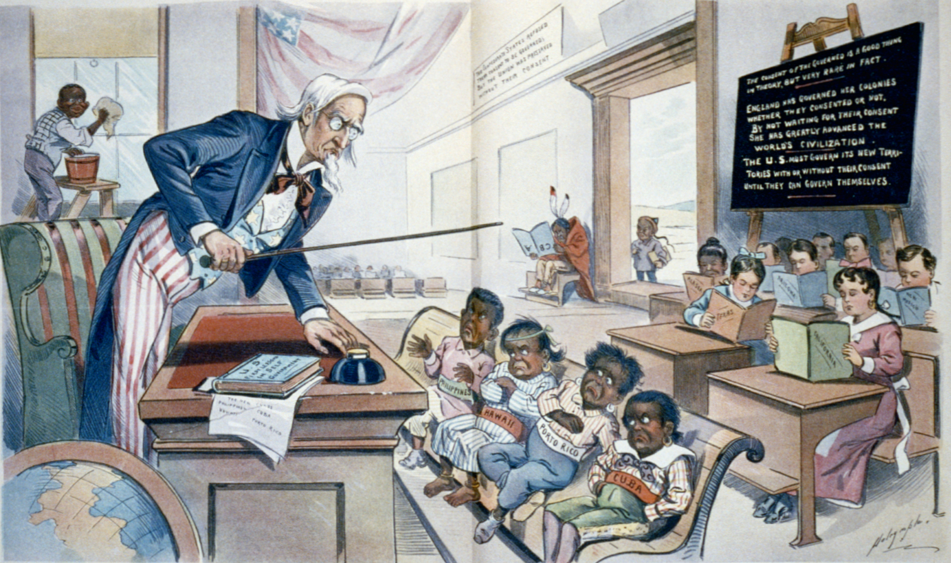
Notes:
traditional racial stereotypes for non-whites depicted them as apes, lesser men, primitives, children, madmen, beings with special powers etc. → Social Darwinism
image: http://upload.wikimedia.org/wikipedia/commons/e/e7/School_Begins_1-25-1899.JPG

Slide 3
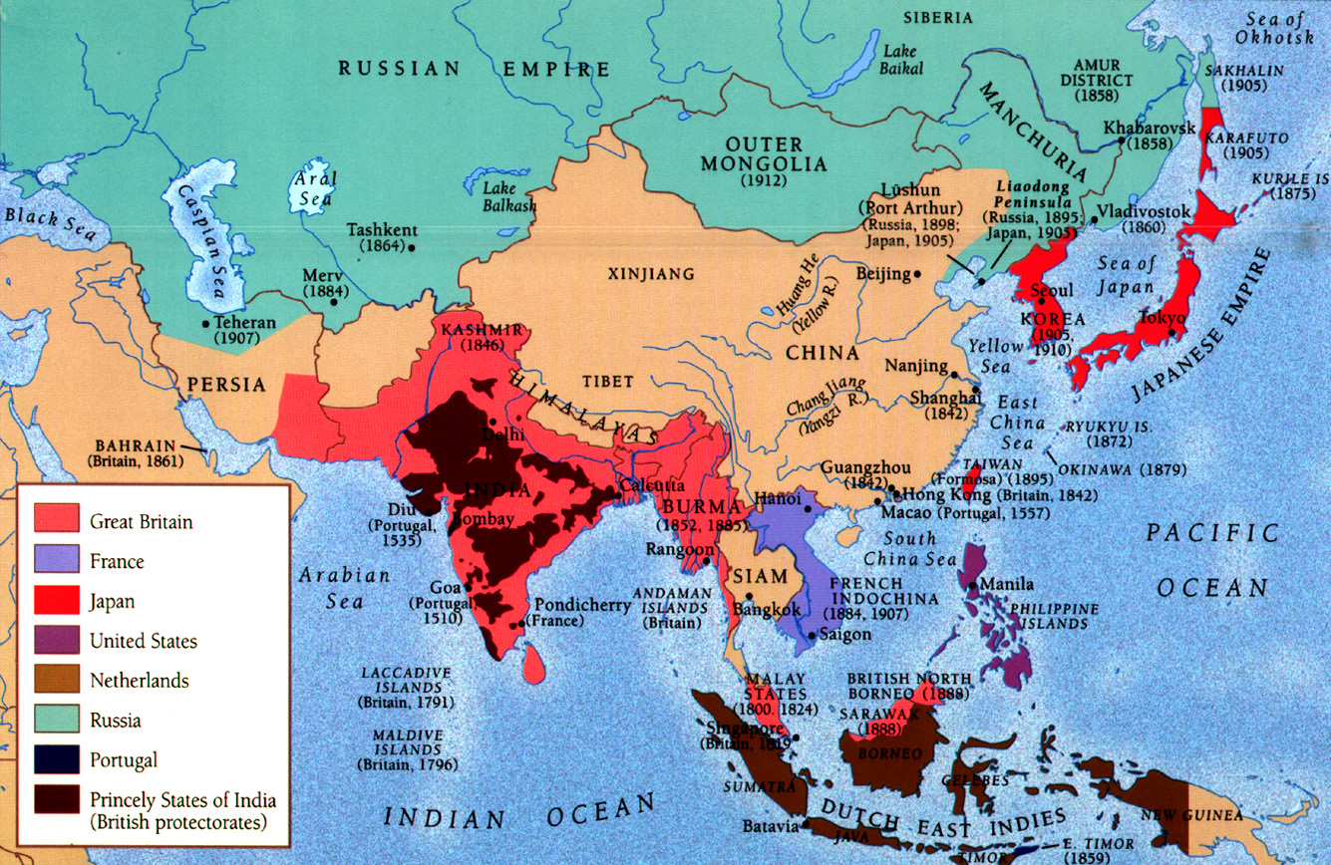
Japan’s invasion of Western colonies in Asia challenged Western ideas of racial and cultural superiority
Notes:
map of colonial Asia
http://mapcollection.files.wordpress.com/2012/07/mapcolonialasia.jpeg

Slide 4
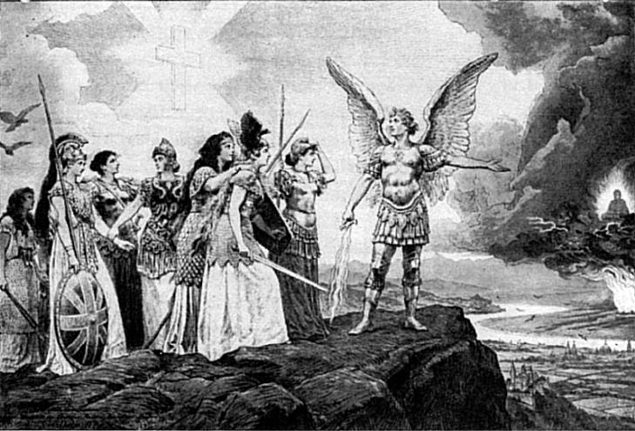
Yellow Peril
Notes:
fear of Asians (primarily China and/or Japan) uniting against the West
http://de.wikipedia.org/wiki/Gelbe_Gefahr#mediaviewer/Datei:Voelker_Europas.jpg

Slide 5
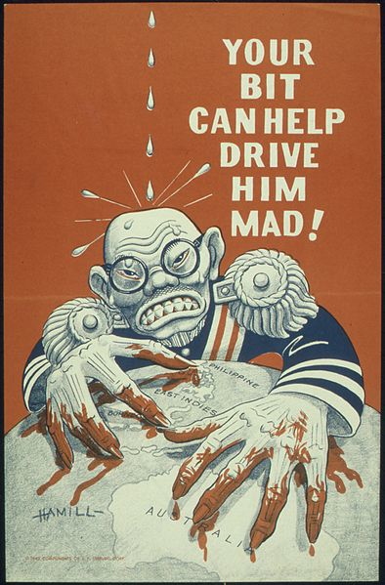
Notes:
Japan’s Pan-Asianism threatened to make Yellow Peril a reality
Pearl Harbor proved Asian nations could master Western military technology → “Asian hordes” were organized and armed
image: http://commons.wikimedia.org/wiki/File:%22YOUR_BIT_CAN_HELP_DRIVE_HIM_MAD%22_-_NARA_-_513615.jpg

Slide 6
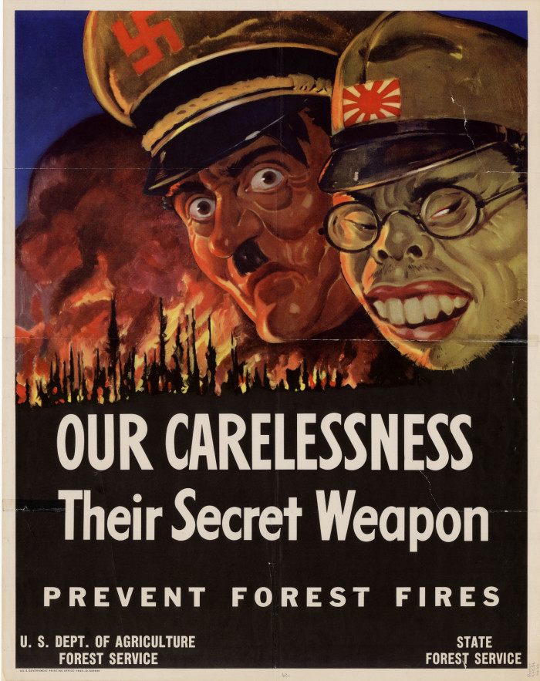
Notes:
the fighting in the Pacific was more savage than in the European theatre → no prisoners, fought to death → affected US propaganda on Japan (compare the portrayal of Hitler to that of Tojo)
Use the following slides to discuss the racial imagery that was used to portray the Japanese
image; http://digital.library.unt.edu/ark:/67531/metadc494/m1/1/

Slide 7
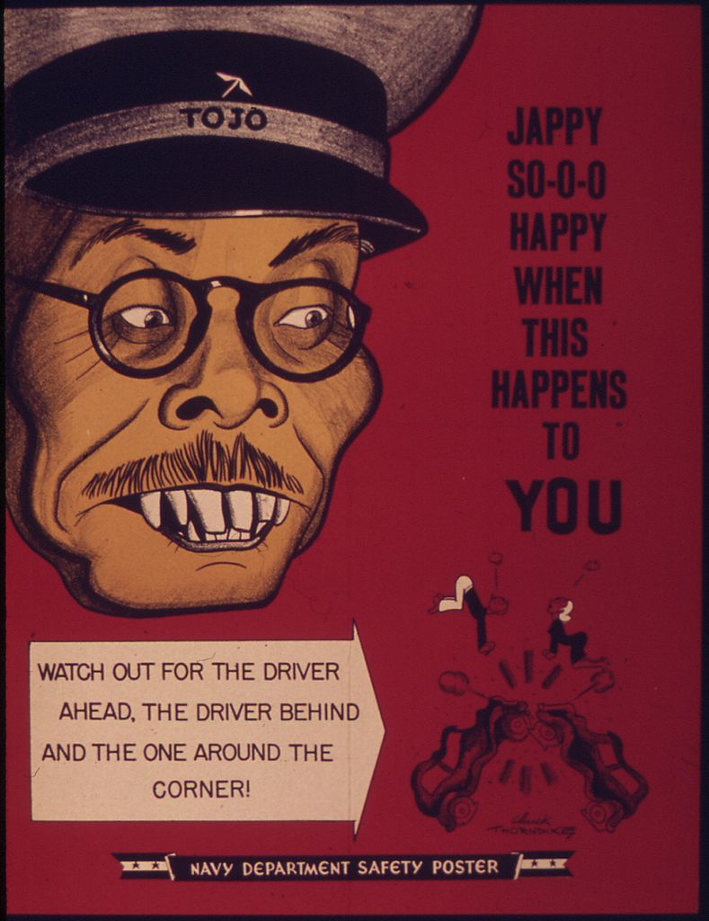
Notes:
image: http://commons.wikimedia.org/wiki/File:%22Jappy_So-o-o_Happy_When_This_Happen_to_You%22_-_NARA_-_514676.jpg

Slide 8
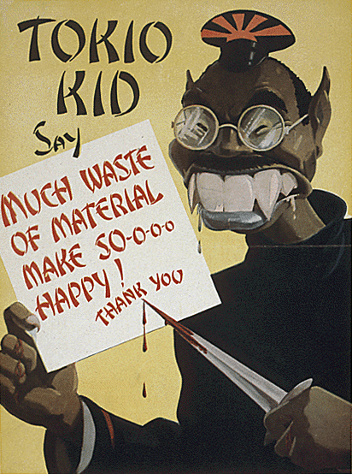
Notes:
http://commons.wikimedia.org/wiki/Category:Tokio_Kid_Say#mediaviewer/File:Tokio_Kid_Say.png

Slide 9
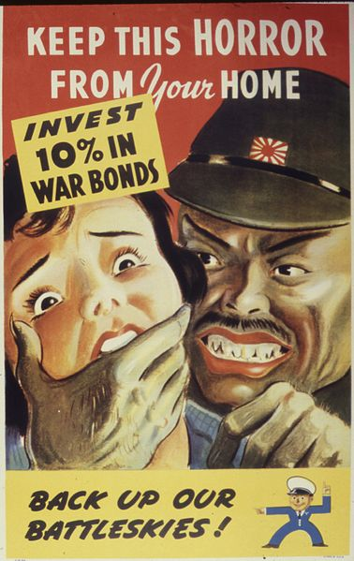
Notes:
Images of non-white men lusting after white women have been very popular in Western propaganda.
http://commons.wikimedia.org/wiki/File:Keep_this_Horror_From_Your_Home._Invest_10_Percent_in_War_Bonds_Back_Up_our_Battleskies%5E_-_NARA_-_534105.jpg

Slide 10
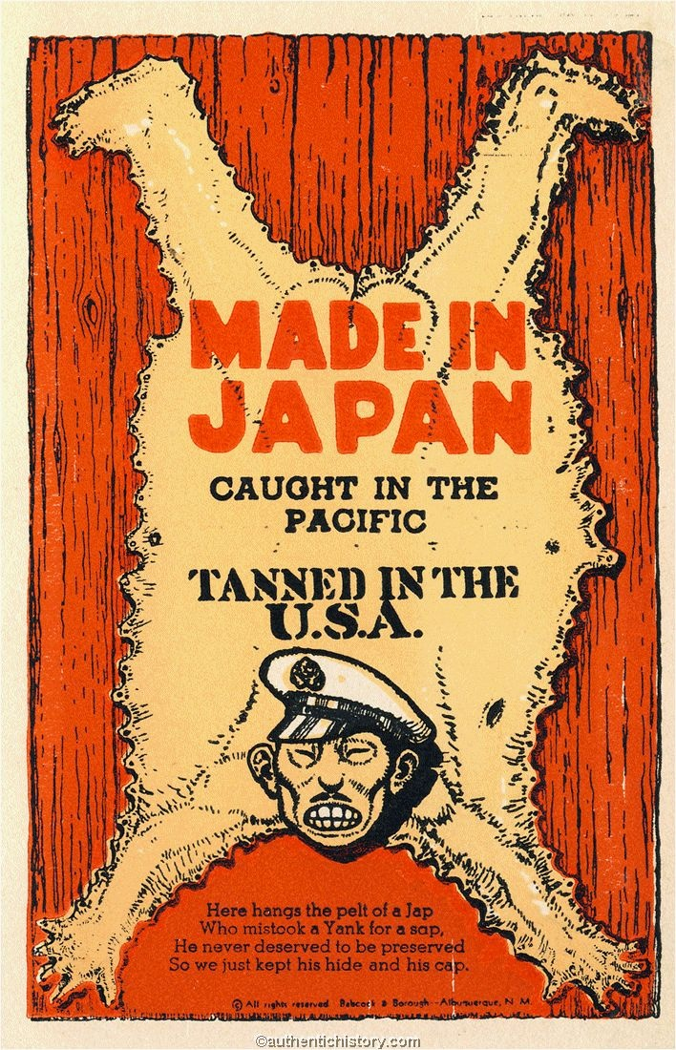
Notes:
“Here hangs the pelt of a Jap, who mistook a Yank for a sap; He never deserved to be preserved, so we just kept his hide and his cap.”
http://authentichistory.com/1939-1945/2-homefront/3-anti-jap/index.html

Slide 11
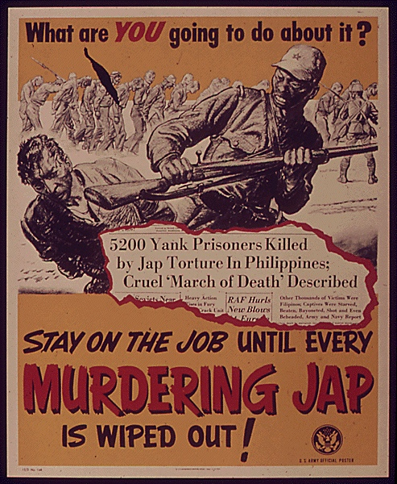
Notes:
the portrayal of the Japanese was linked to American self-perception and the necessity to justify killing Japanese soldiers.
image: http://www.bookmice.net/darkchilde/japan/posters/a4.jpg

Slide 12
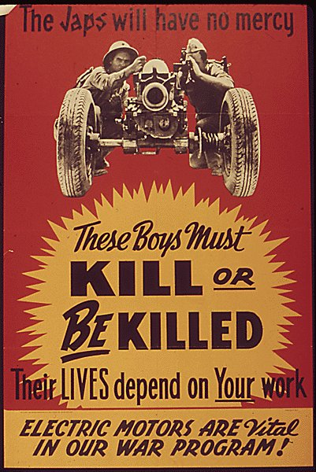
Notes:
http://www.bookmice.net/darkchilde/japan/posters/Image109.jpg

